Slide 1


ETHICS FOR TRANSPORTATION PROFESSIONALS
108th TRC MEETING
2019 Transportation Engineering Conference
Hot Springs Convention Center, Hot Springs, AR
August 14, 2019
William D. Lawson, P.E., Ph.D.
Murdough Center for Engineering Professionalism
Texas Tech University, Lubbock, TX

Slide 2

PART 1. INTRODUCTION AND OPENING REMARKS…
ETHICS FOR TRANSPORTATION PROFESSIONALS

Slide 3
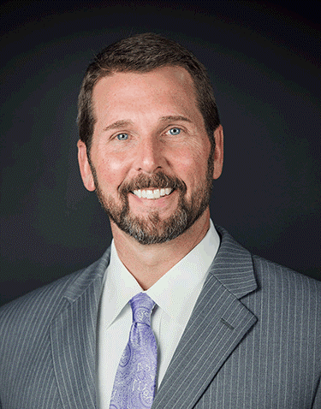
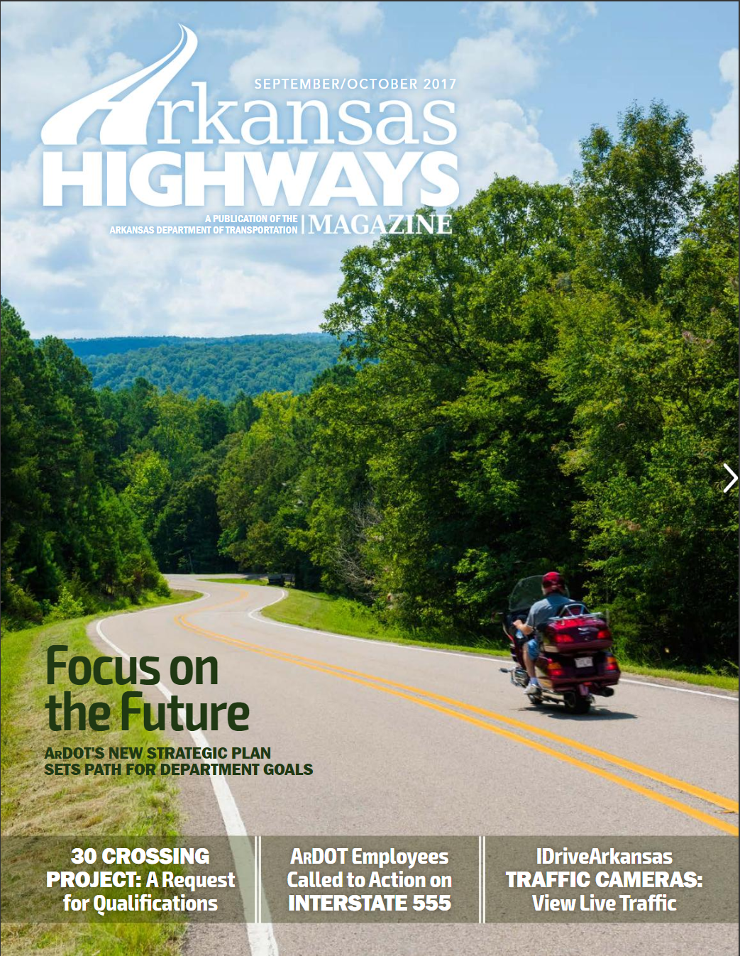
DIRECTOR’S Welcome
SCOTT E. BENNETT, P.E.
Director, ArDOT

Slide 4
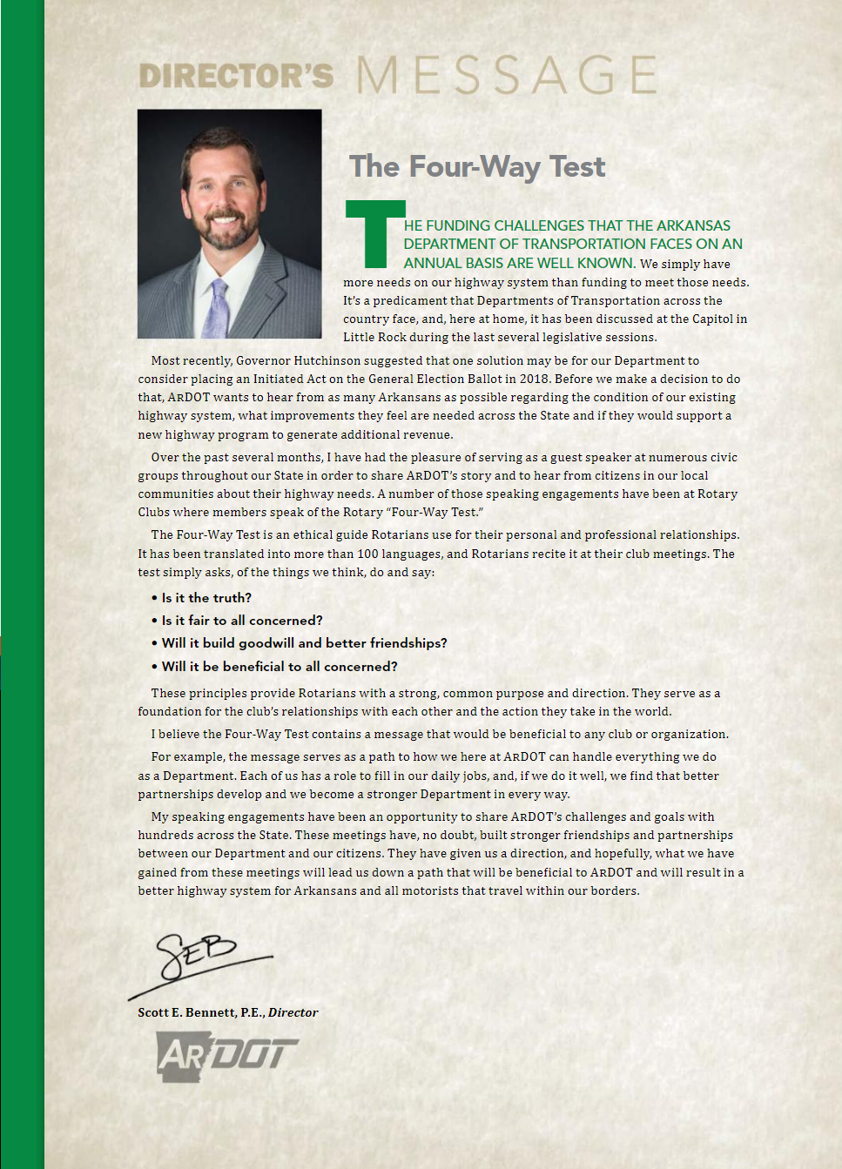

Slide 5
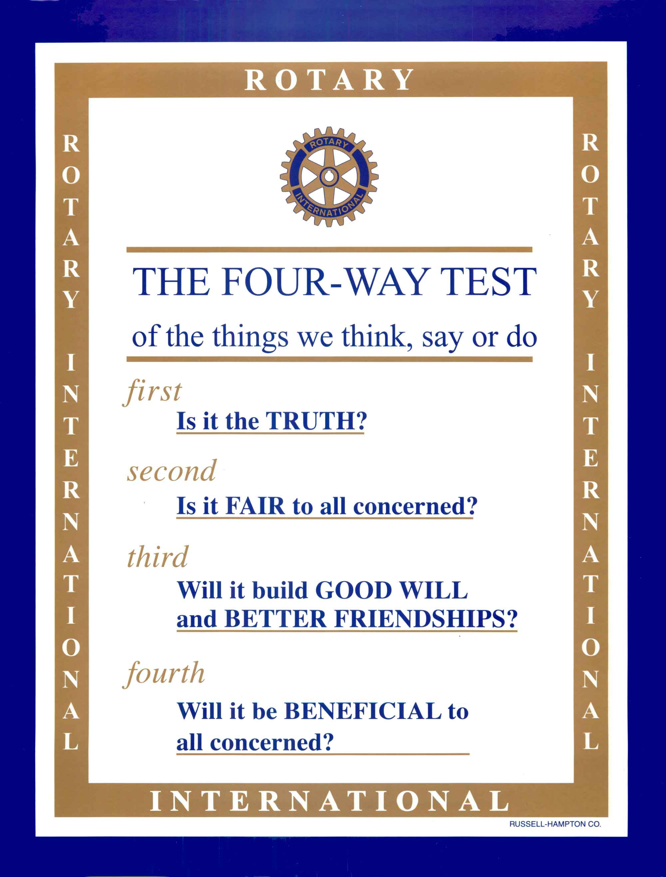
The Four-Way Test
ROTARY INTERNATIONAL

Slide 6
The FOUR-WAY Test
“I believe the Four-Way Test contains a message that would be beneficial to any club or organization… For example, the message serves as a path to how we here at ArDOT can handle everything we do as a Department. Each of us has a role to fill in our daily jobs, and, if we do it well, we find that better partnerships develop and we become a stronger Department in every way…”
- Scott E. Bennett, P.E., Director

Slide 7
ABOUT You, the AUDIENCE
Your name
Office/ home
Job position/ title
Years employment (with the Agency)
What you would like to gain from today’s workshop

Slide 8

ABOUT the INSTRUCTOR
William D. Lawson, PE, PhD
Texas Tech University, Lubbock, TX
Geotechnical Engineer, Associate Professor
35+ years total/ 21 years at Tech
Good, positive interaction with you all on a topic I care about very deeply

Slide 9
Learning Objectives
Upon completion of this course, learners will be able to:
Identify ethical standards relative to professional conduct and ethics for professional engineers
Interpret and apply guidance relative to analyzing typical ethical dilemmas
Demonstrate ethical problem solving skills for selected engineering situations.

Slide 10

Ethics and Honesty
Mom takes three kids to the movie…

Slide 11
Ethical standards…
Learning Objective 1

Slide 12
Arkansas Department of Transportation

Slide 13
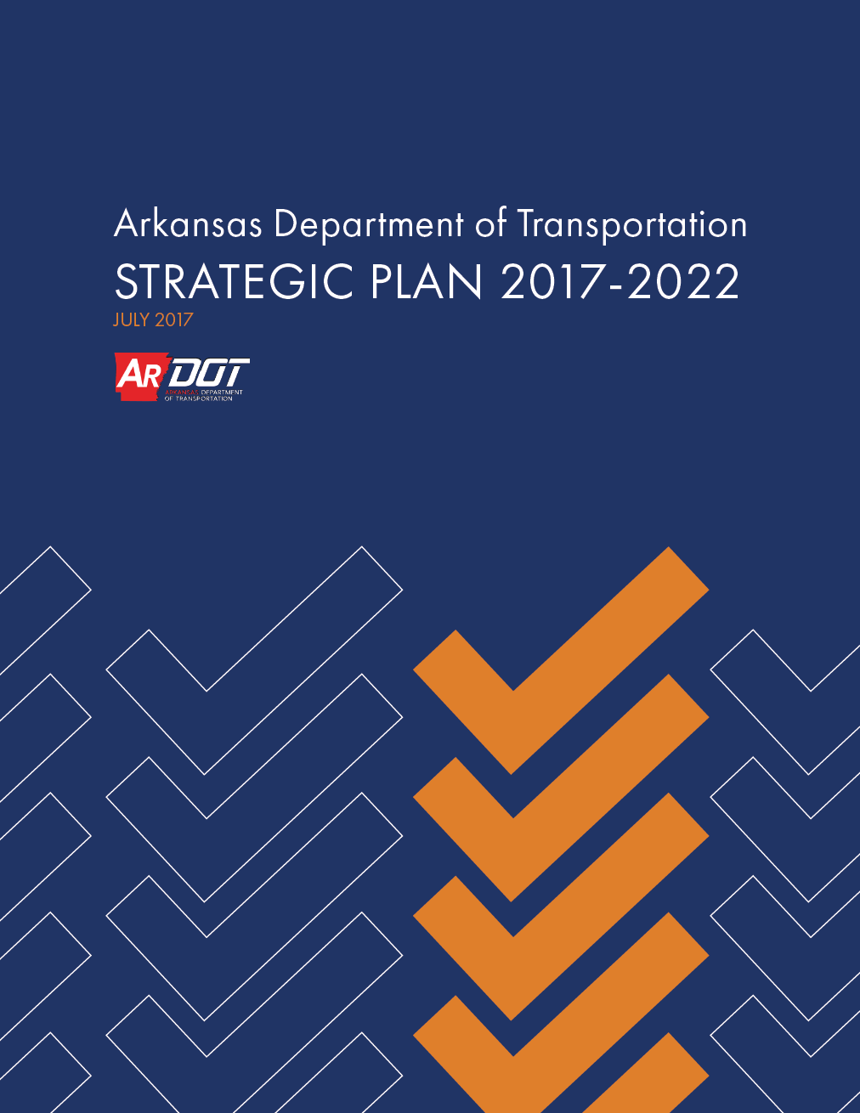
Mission and Vision
Arkansas Department of Transportation
Mission Statement
Provide safe and efficient transportation solutions to support Arkansas’ economy and enhance the quality of life for generations to come.
Vision Statement
Continue to preserve and improve Arkansas’ transportation system emphasizing safety, efficiency, quality, trust, and stewardship with a public service focused workforce.

Slide 14
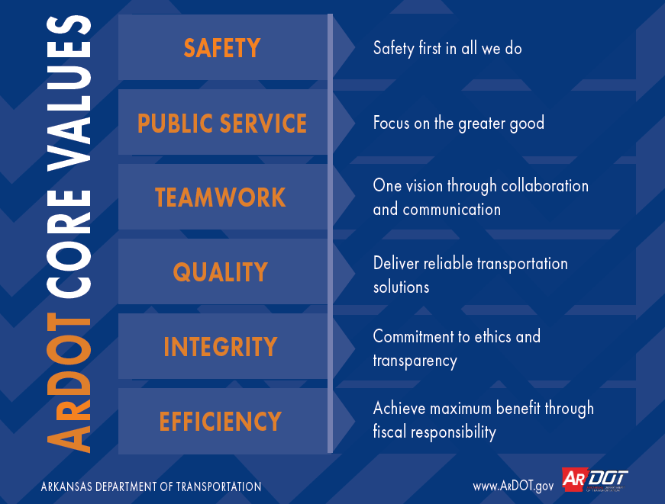

Slide 15
Anti-Fraud and Code of Ethics
Arkansas Department of Transportation (Revised 7/2018)
The Department’s Code of Ethics (Code) is the written document that supports the culture of ethical and efficient service to the citizens of the State provided by the Department. The Code describes the behavior expected of employees that perform these services. Employees must comply with all applicable laws and regulations…
SOURCE: ARDOT Personnel Manual

Slide 16

Arkansas Board of Licensure for Professional Engineers and Professional Surveyors

Slide 17
RULES OF THE BOARD
ARTICLE 22. ETHICS AND PROFESSIONAL CONDUCT
The following Rules of Professional Conduct shall be binding on every person holding a Certificate of Licensure. The Rules of Professional Conduct delineate specific obligations the licensee must meet. In addition, each licensee is charged with the responsibility of adhering to standards of highest ethical and moral conduct in all aspects of the practice of Professional Engineering and Professional Surveying.

Slide 18

National Society of Professional Engineers

Slide 19
Fundamental Canon 1.
NSPE Code of Ethics for Engineers
Engineers, in the fulfillment of their professional duties, shall hold paramount the safety, health, and welfare of the public.

Slide 20
Excellence →
ETHICS: The obligations and ideals to which we aspire.
ETHICS
←Adequacy
LAW
Notes:
This slide summarizes the distinction I’m seeking to make between law and ethics….

Slide 21
ETHICS FOR TRANSPORTATION PROFESSIONALS
PART 2. ETHICS FILM… MAJOR CASE STUDY

Slide 22
Interpret and apply…
Learning Objective 2

Slide 23
Gilbane Gold
A Case Study in Engineering Ethics copyright 1989 NIEE
Notes:
Text, pp144-45

Slide 24
Gilbane Gold
Synopsis
Gilbane Gold is the name given to dried sludge from the Gilbane wastewater treatment plant. It is sold to farmers as a commercial fertilizer. The annual revenue generated saves the average family about $300 per year in taxes.
Several years ago the city of Gilbane established limits on the discharge of heavy metals to the sewers in order to protect Gilbane Gold from the build-up of toxic materials that could end up in the soil. The limits are more restrictive than federal limits but are based on the concentration of the discharge with no restriction on total weight of discharged material.
Notes:
Text, pp144-45

Slide 25
Gilbane Gold
Synopsis, continued
Z CORP, a computer components manufacturer, discharges wastewater containing small amounts of lead and arsenic into the city sewers. By the current city test standards, the discharge usually meets allowable levels. Z CORP people know of a newer test which shows that the discharge exceeds the limits.
The ethical dilemma is: Should Z CORP tell the city about the new test? Acceptance of the new test would require additional investment in clean-up equipment by Z CORP. Word leaks and a TV investigation begins.
Notes:
Text, pp144-45

Slide 26
Gilbane Gold
Cast of Characters
DAVID JACKSON …. Environmental engineer working for Z CORP
TOM RICHARDS …. Engineering consultant fired by Z CORP for espousing the new test standards
PHIL PORT …. Manager and head of Z CORP's environmental affairs department
FRANK SEEDERS …. Z CORP's engineering manager
DIANE COLLINS …. VP in charge of Z CORP's Gilbane plant
LLOYD BREMEN …. Former state commissioner of environmental protection
WINSLOW MASSIN …. Professor emeritus, School of Engineering, Hanover University
MARIA RENATO …. TV reporter
Notes:
Text, pp144-45

Slide 27
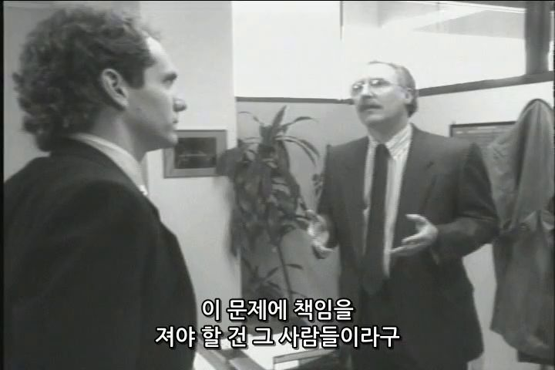
Gilbane Gold
FILM (00:23:25)
Notes:
Text, pp144-45

Slide 28
Gilbane Gold
Discussion
Identify a few (two or three) major ethical issues from this case study
It is up to ZCORP management to protect the environment? If so, to what degree?
Assume you are the President of ZCORP, and you become aware of this matter from the news report. Identify two or three actions you would immediately take to address this situation
Notes:
Text, pp144-45

Slide 29
ETHICS FOR TRANSPORTATION PROFESSIONALS
PART 3. ETHICAL REASONING AND PROBLEM SOLVING

Slide 30
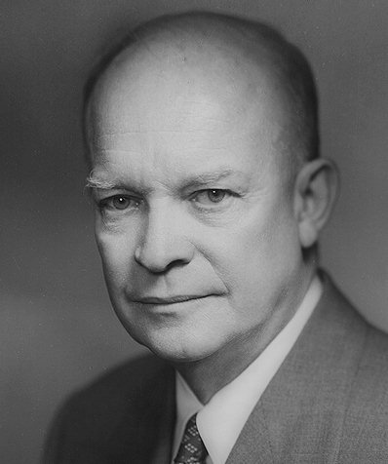
My Favorite Ethics Quote
“No man can always be right, so the struggle is to do one’s best to keep the brain and conscience clear;
Never to be swayed by unworthy motives or inconsequential reasons,
But to strive to unearth the basic factors involved
And then do one’s duty.”
-Dwight D. Eisenhower
34th President of the United States

Slide 31

A Suggested Course of Action When Facing an Ethical Dilemma
How should you handle an ethical dilemma?
This series of slides presents a five-step process to help you work through ethical problems, the central goal being ethical attitudes and actions.

Slide 32

STEP 1:
Gather the information needed to make a good decision.
Get the facts. Make sure you have accurate and complete information regarding the situation.
Distinguish between what you know from what is uncertain or is based on hearsay.
Identify the stakeholders. Make a list of every individual, group or organization that has something significant to gain or lose in the resolution of the problem, noting what is at stake for them and the ethical standards that apply to each one.

Slide 33

STEP 2:
Determine what ethical standards apply to the situation.
Review ethics guidance relative to the issue.
If you are a licensed professional, check the ethics provisions of your licensure law.
Use other resources available to you including your peers and supervisors.

Slide 34
STEP 3:
Clarify the key concepts in the ethical dilemma.
The idea is to reduce the problem to its core ethical issues. An ethical dilemma typically takes the form of one good thing (e.g., keeping your promises) versus another good thing (e.g., preventing harm).
Both of these – keeping promises and preventing harm – are important ethical obligations.
This is no easy dilemma to solve

Slide 35
If the “Ethics Rope” Breaks
Ethics
FUNDAMENTALS OF ETHICS

Slide 36
STEP 4:
Prepare to solve the problem.
Develop at least two possible alternative solutions.
Systematically evaluate the alternatives using the ethical standards identified, the interests of the major stakeholders in the situation, and related factors.
Weigh the costs of each possible solution to each stakeholder. The process of evaluation may turn up new questions and problems requiring further investigation.
Choose the best alternative, using your judgment to balance the competing ethical obligations and goals.
Develop a strategy to put your solution into action.

Slide 37
STEP 5:
Act!
The previous steps are directed toward helping you with this critical aspect of ethical problem solving.
However, once you know the right thing to do, the other critical aspect is to actually DO THE RIGHT THING! For many of us, this is the hard part.
Here, moral courage comes into play. If left unattended, ethical problems rarely solve themselves. The key is to take well-considered action. Ultimately, you must do this, relying on the assistance of your coworkers, supervisors, friends and others.

Slide 38

“Run towards the roar…”

Slide 39
MAINSTREAM ETHICS: Professional practice challenges you will see

Slide 40
“Mainstream”
accustomed, average, commonplace, conventional, customary, daily, dime a dozen, everyday, expected, familiar, frequent, garden-variety, general, humdrum, matter of course, middle of the road, natural, normal, obvious, ordinary, pedestrian, plain, prevalent, regular, routine, run of the mill, standard, stock, typical, unexceptional, unremarkable, usual, vanilla, widespread, workaday

Slide 41
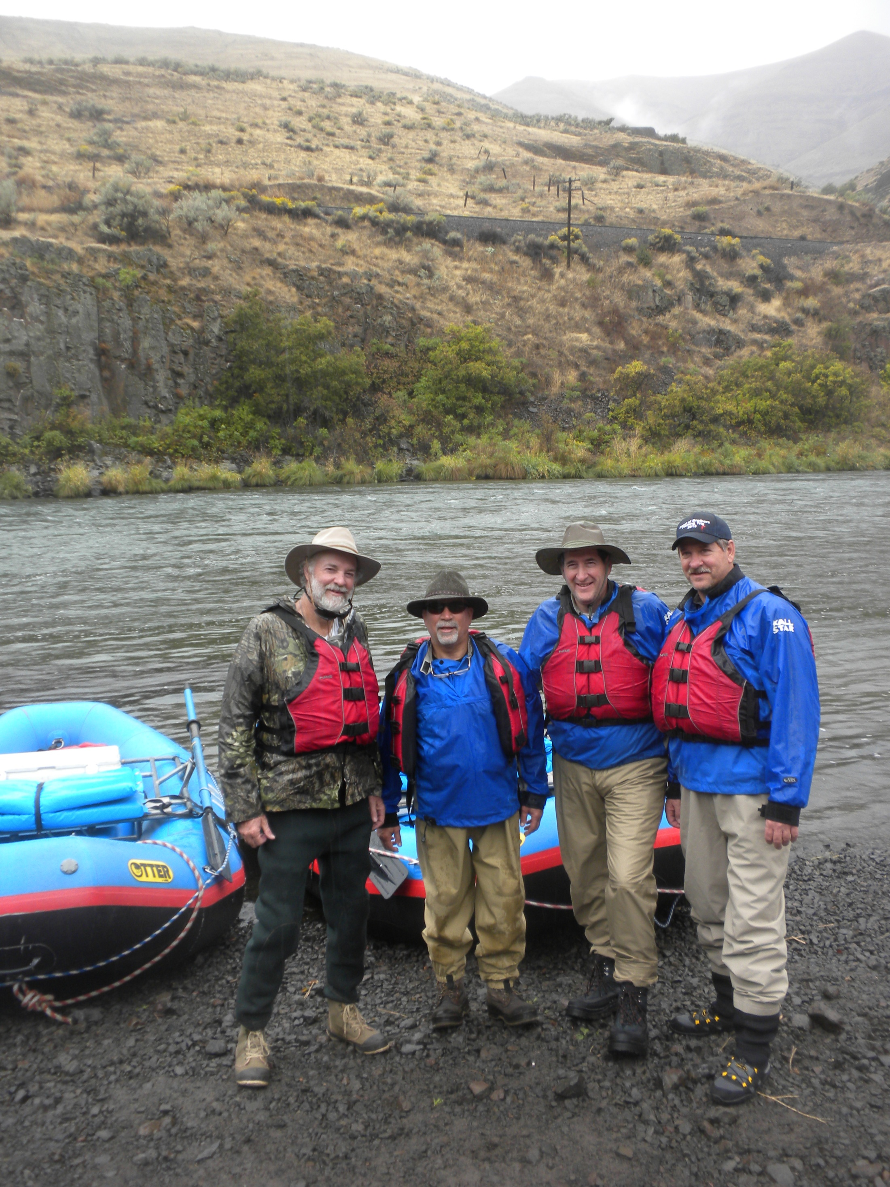
Deschutes River/ RM42.8 Buckhollow/ 24 SEP 2013/ WDL

Slide 42
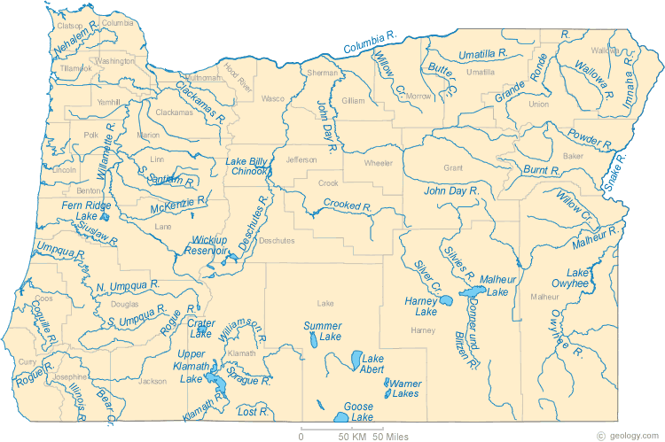
Oregon Rivers/ geology.com

Slide 43
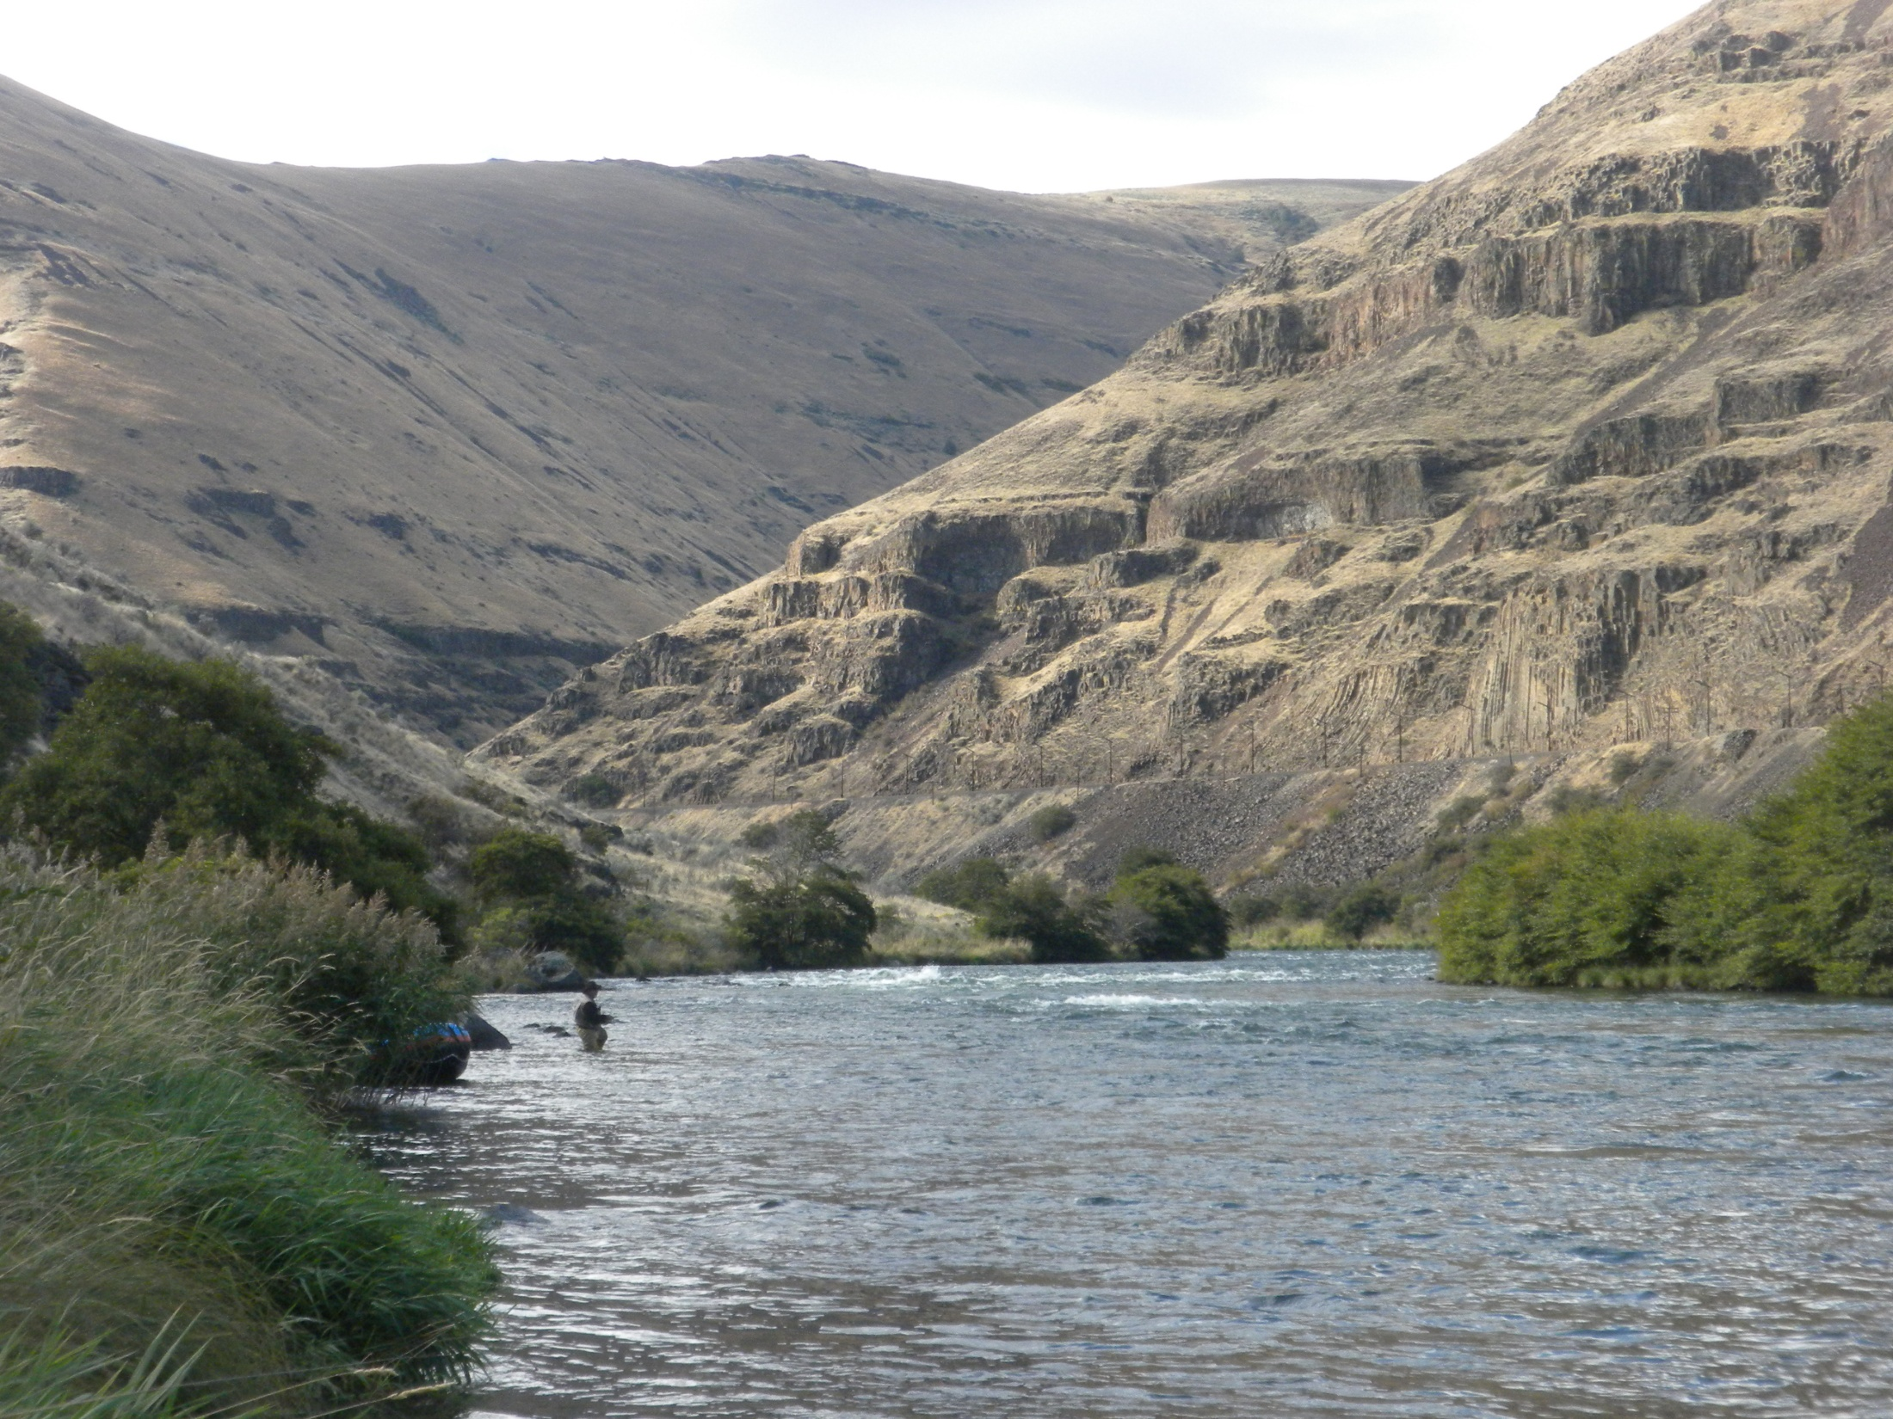
DESCHUTES RIVER
Deschutes River/25 SEP 2013/ WDL

Slide 44
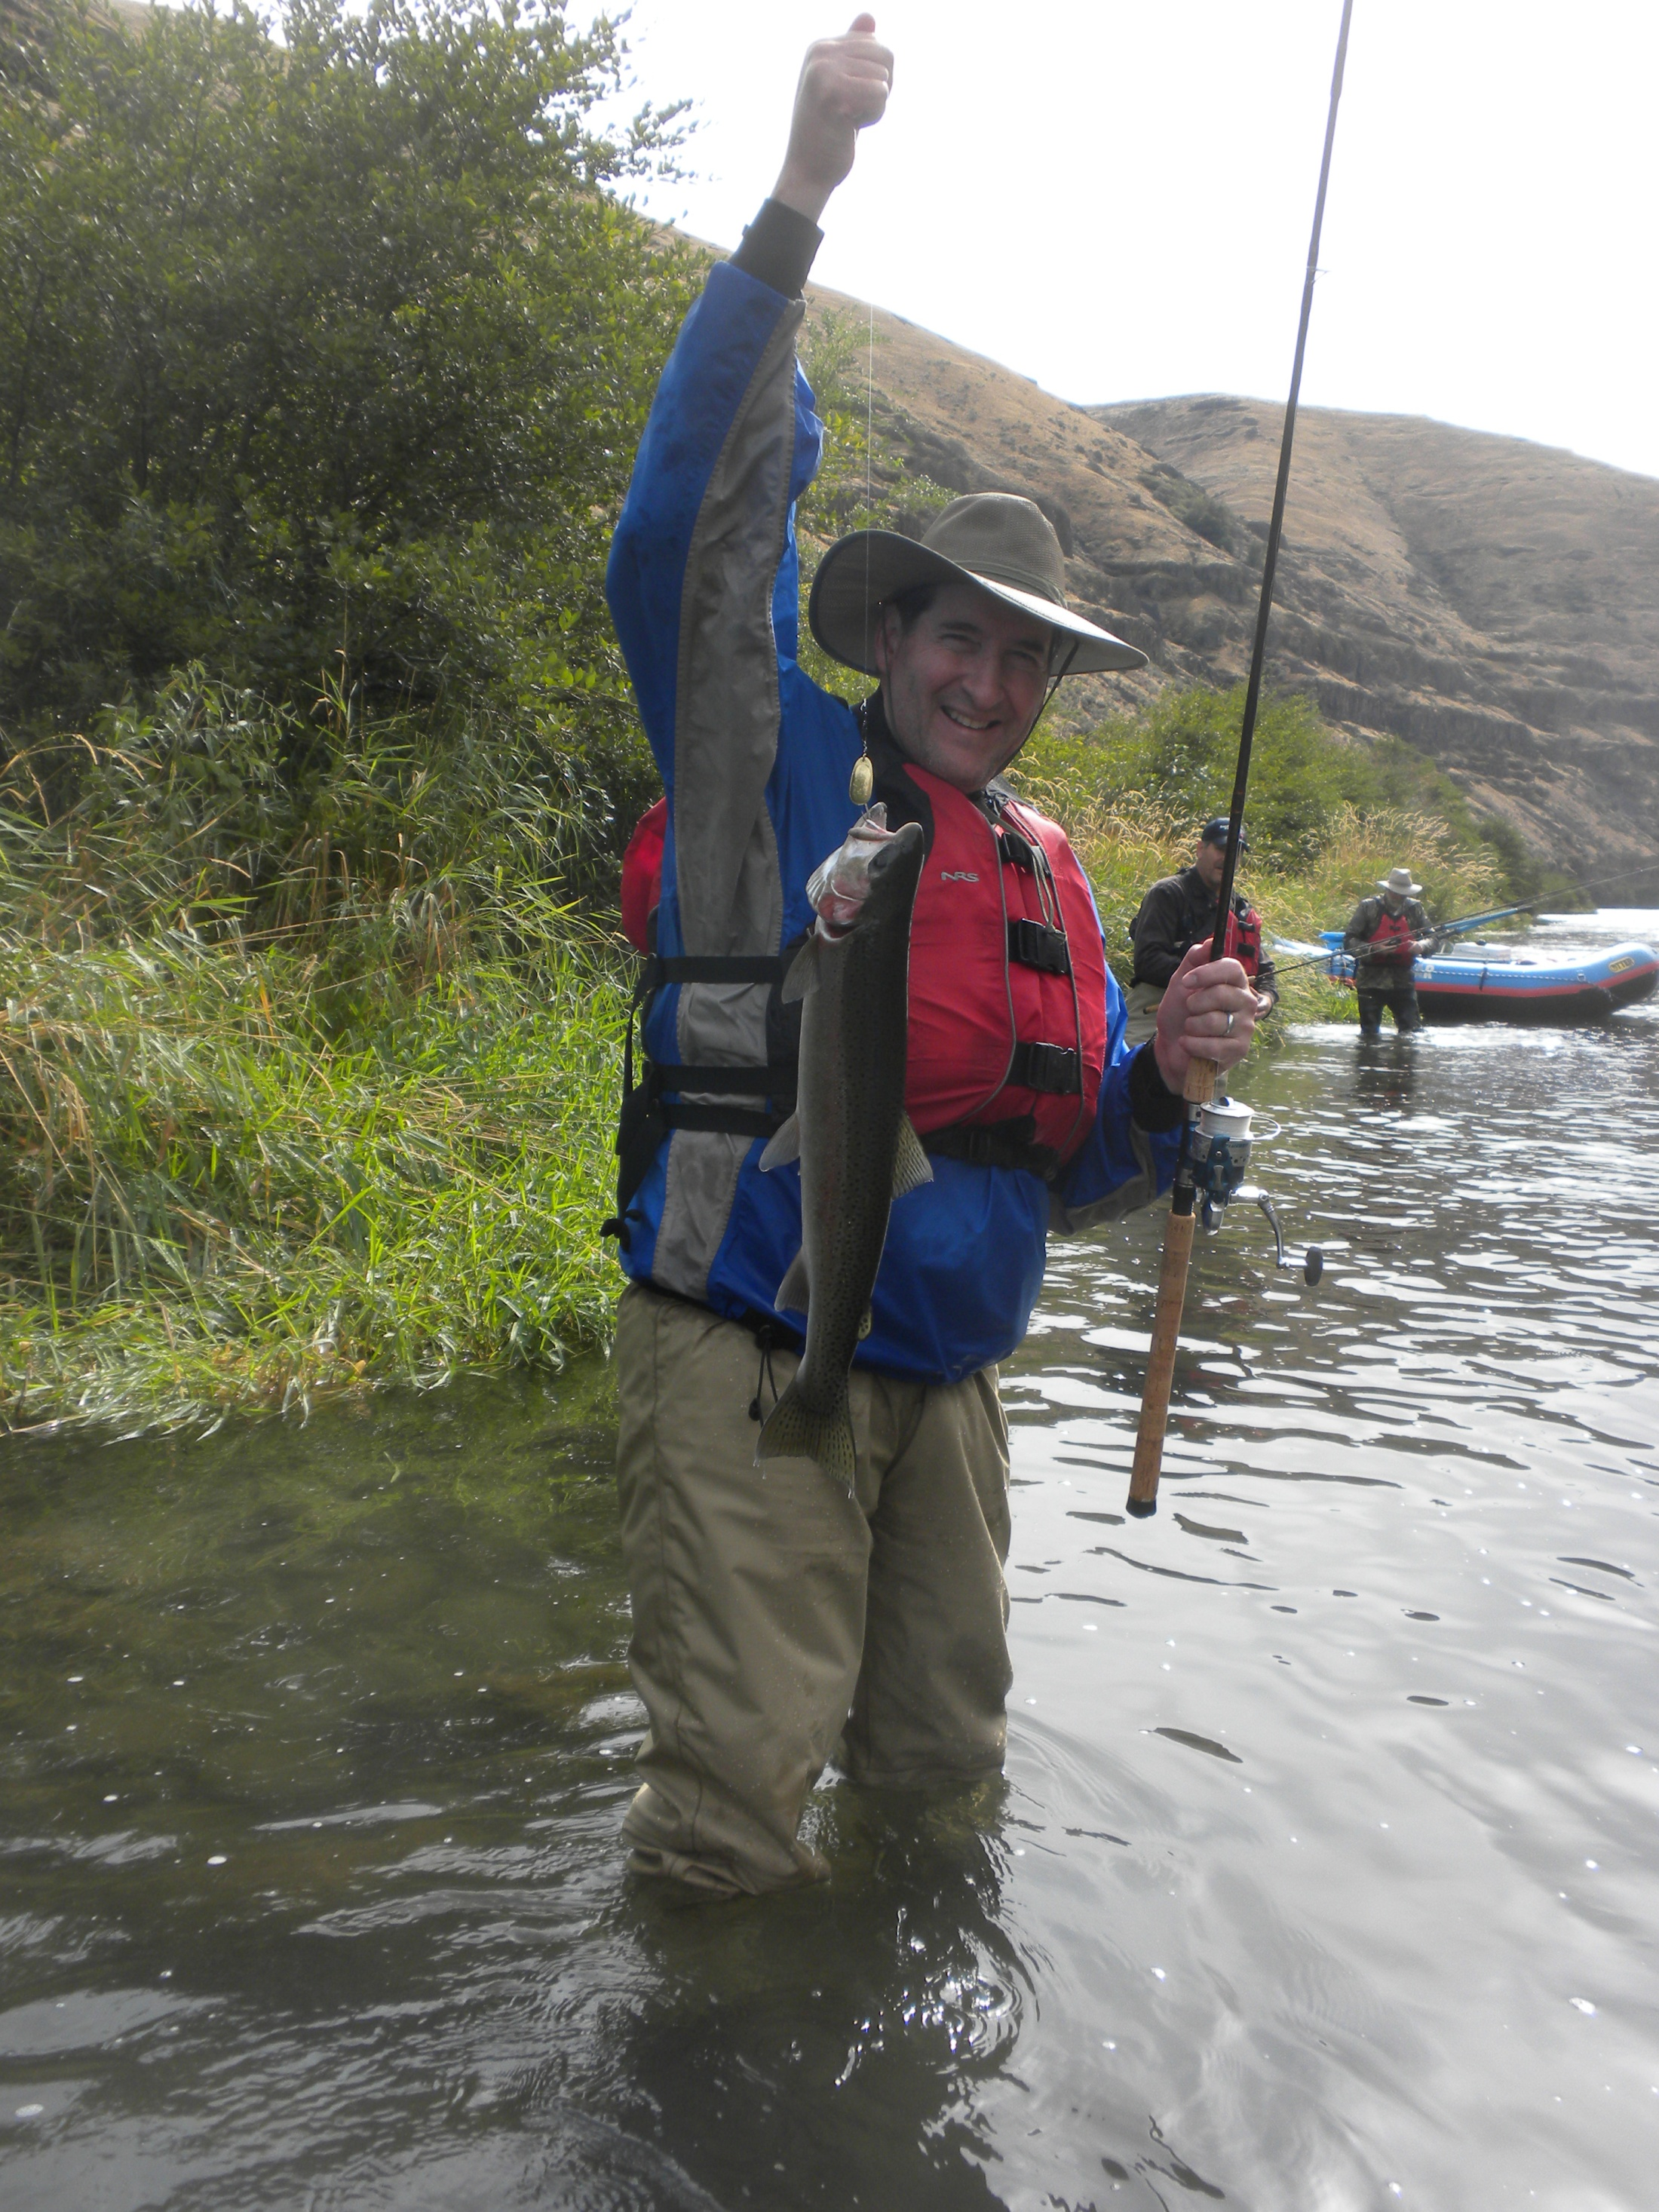
Bill Lawson/ Deschutes River/24 SEP 2013

Slide 45

NSPE Board of Ethical Review

Slide 46
NSPE Board of Ethical Review
The Board of Ethical Review is a panel of engineering ethics experts that has served as the profession's guide through ethical dilemmas
The board consists of seven licensed members who are appointed by the NSPE president
The purpose of the BER is to render impartial opinions pertaining to the interpretation of the NSPE Code of Ethics…

Slide 47
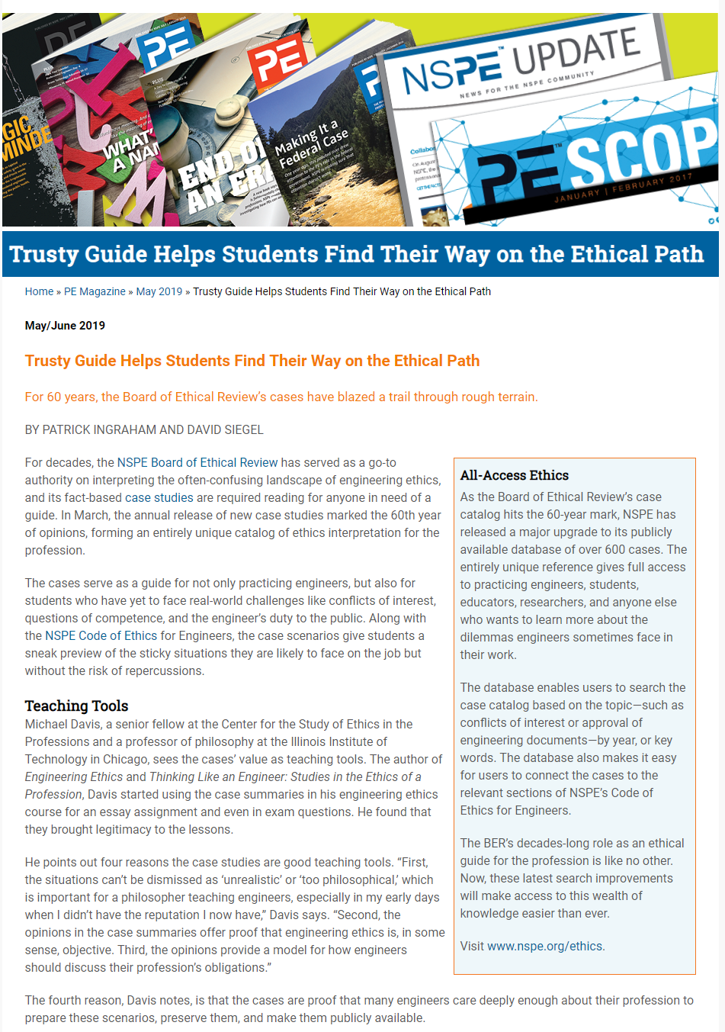

Slide 48
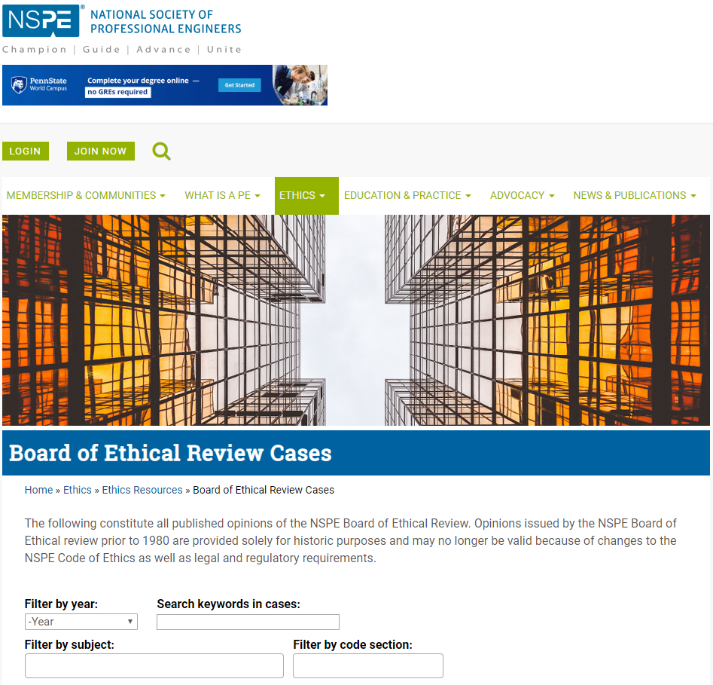
Board of Ethical Review Cases

Slide 49
https://www.nspe.org/resources/ethics

Slide 50
ethical problem solving…
Learning Objective 3

Slide 51

CASE 1… CONFLICT OF INTEREST
Conflict of Interest: State Engineer – Village Road

Slide 52
CASE 1
Source: Opinions of the NSPE Board of Ethical Review
Case 07-1
Conflict of Interest: State Engineer – Village Road

Slide 53
CASE 1
Conflict of Interest: State Engineer – Village Road
FACTS:
Engineer A, a licensed professional engineer, is employed by the State Department of Transportation as a district engineer... As district engineer, Engineer A supervises other state department of transportation engineers and has authority over the use of state and federal highway funds. Engineer A owns a parcel of land in the state. Consideration is being given to new roads with links to the interstate highway passing through the state. Engineer A’s property would benefit from the building of a new road that would connect a village where Engineer A’s property is located….

Slide 54
CASE 1
Conflict of Interest: State Engineer – Village Road
QUESTION:
Was it ethical for Engineer A to approve the building of the additional road to the village where Engineer A’s property is located?

Slide 55
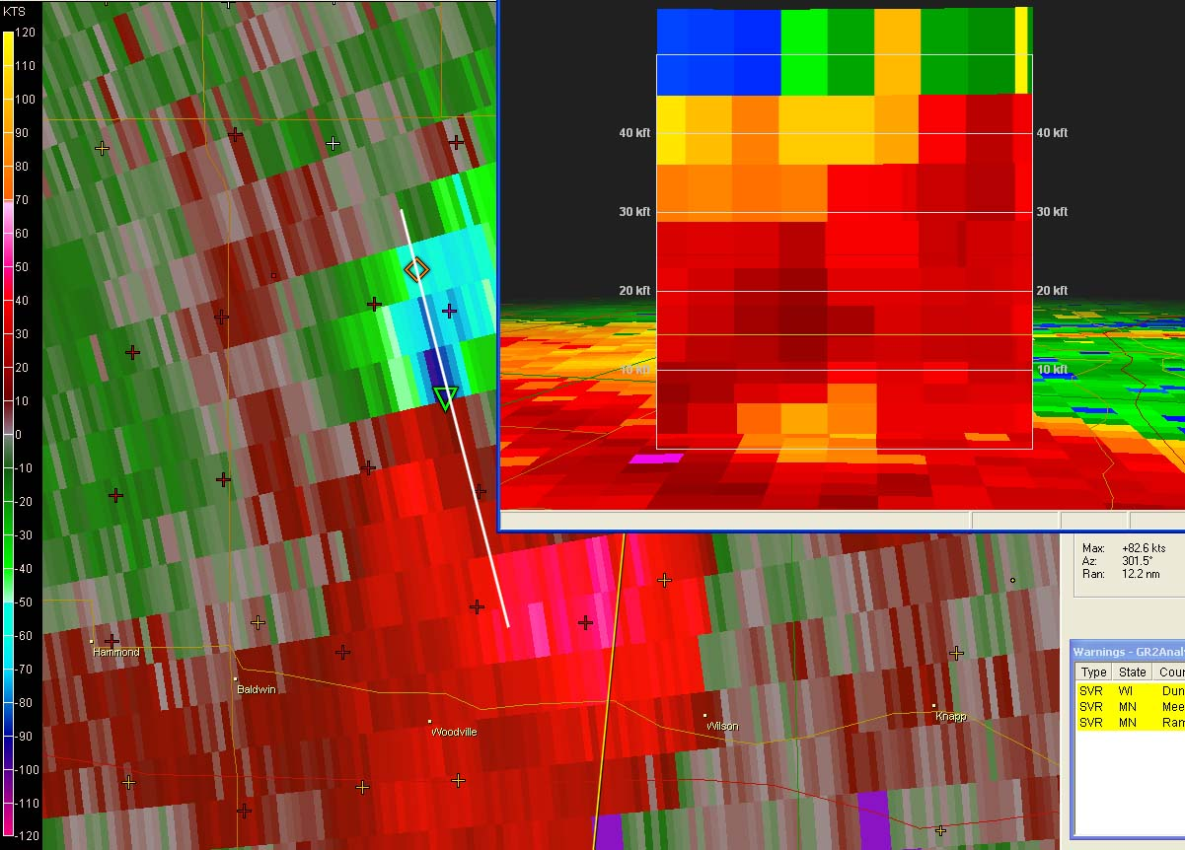
CASE 2 - COMPETENCE
Professional Competence in Current Structural Design

Slide 56
CASE 2
Source: Opinions of the NSPE Board of Ethical Review
Case 02-5
Professional Competence in Current Structural Design

Slide 57
CASE 2
Professional Competence in Current Structural Design
FACTS:
Engineer A is involved in the design of the structural system on a building project in an area of the country that experiences severe weather conditions. Engineer A, who has experience with structural designs in this area of the country, designs the structural system based upon what Engineer A believes constitutes sound structural engineering principles. Although Engineer A has knowledge and experience in structural design, new and improved design methods have recently been developed. …

Slide 58
CASE 2
Professional Competence in Current Structural Design
QUESTION:
Was it ethical for Engineer A to fail to follow the most recent design parameters for structural design in severe weather areas published in the most recent technical literature?

Slide 59

CASE 3… HONESTY
Statements Made During Negotiations

Slide 60
CASE 3
Source: Opinions of the NSPE Board of Ethical Review
Case 05-5
Statements Made During Negotiations

Slide 61
CASE 3
Statements Made During Negotiations
FACTS:
Engineer A is acting as the chief negotiator in the sale of a small engineering subsidiary to Engineer B. Engineer A wants to move the negotiations forward to finalize the deal but Engineer B has been stalling. Engineer C had expressed some initial interest in buying the subsidiary, but following consideration, Engineer C decided she was definitely not interested in purchasing the subsidiary. In an effort to move the negotiations forward, referring to Engineer C’s earlier interest, Engineer A tells Engineer B…

Slide 62
CASE 3
Statements Made During Negotiations
QUESTION:
Was it ethical for Engineer A to make the statement to Engineer B in an effort to move the negotiations forward?

Slide 63
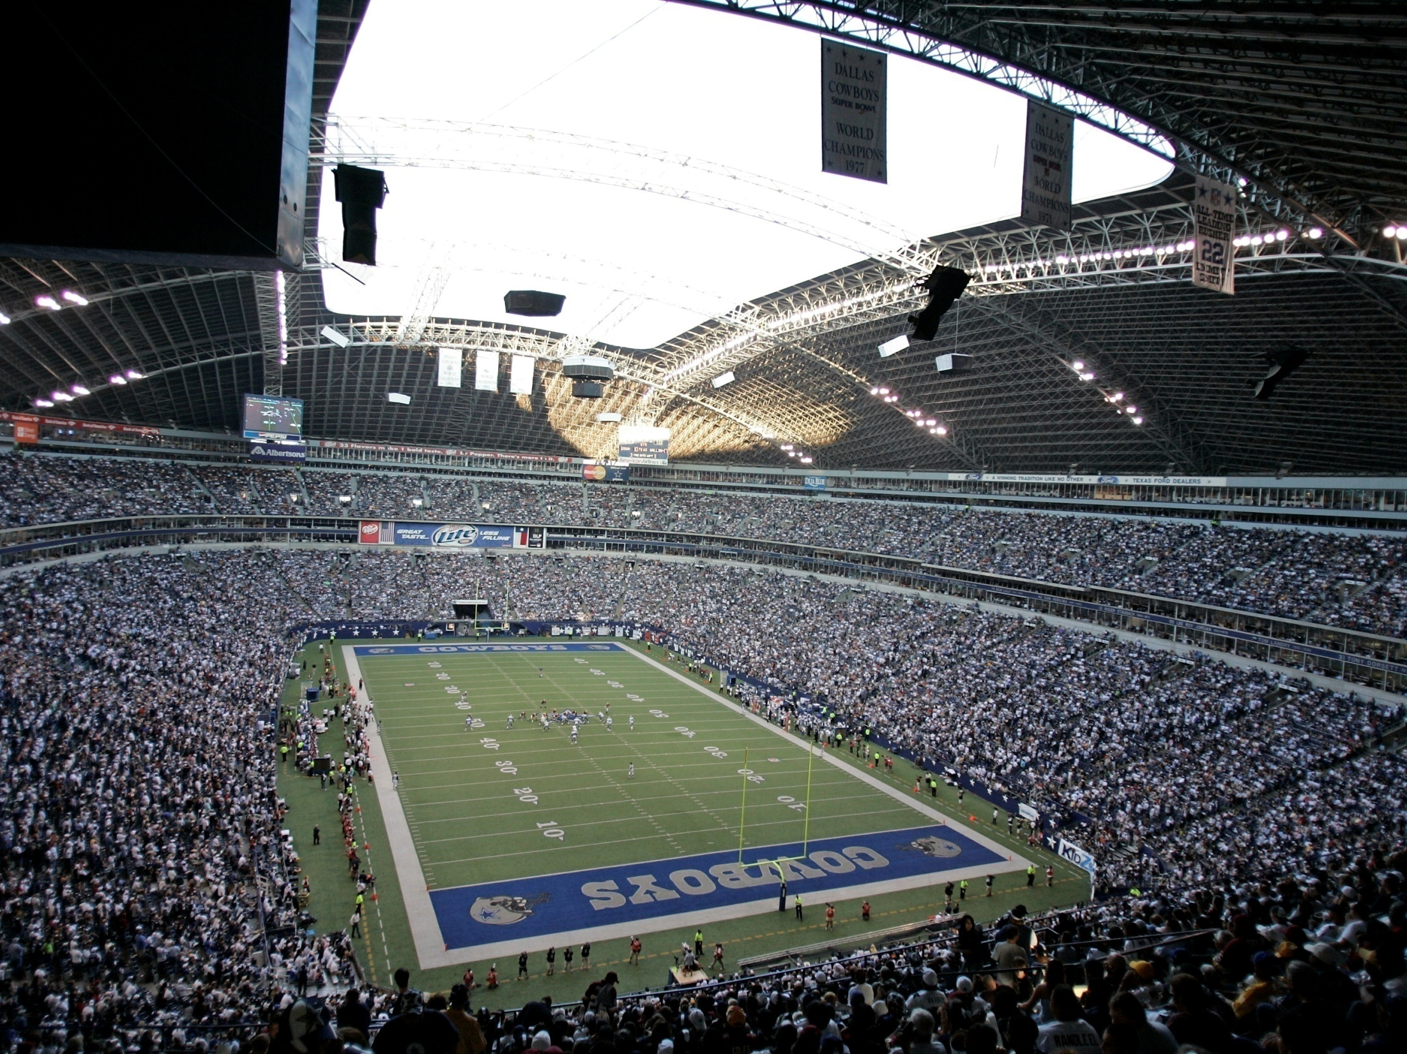
CASE 4… GIFTS
Gifts—State Department of Transportation Employees

Slide 64
CASE 4
Source: Opinions of the NSPE Board of Ethical Review
Case 05-6
Gifts—State Department of Transportation Employees

Slide 65
CASE 4
Gifts—State Department of Transportation Employees
FACTS:
Engineer A performs engineering services as an employee of the State Department of Transportation. Part of Engineer A’s responsibilities is to serve as liaison with the consulting engineers and contractors that perform design and construction work for SDOT. Over the years, following completion of various successful projects, consulting engineering companies (including Engineer B’s company) and contractors have from time to time offered the following to Engineer A…

Slide 66
CASE 4
Gifts—State Department of Transportation Employees
QUESTIONS:
Would it be ethical for Engineer A to accept such gifts as described in 1, 2, 3, or 4?
Would it be ethical for Engineer B to offer such gifts described in 1, 2, 3, or 4?

Slide 67

CASE 5… PUBLIC SAFETY
Public Health and Safety – Code Enforcement

Slide 68
CASE 5
Source: Opinions of the NSPE Board of Ethical Review
Case 98-5
Public Health and Safety – Code Enforcement

Slide 69
CASE 5
Public Health and Safety – Code Enforcement
FACTS:
Engineer A serves as a director of a building department in a major city. Engineer A has been concerned that as a result of a series of budget cutbacks and more rigid code enforcement requirements, the city has been unable to provide a sufficient number of qualified individuals to perform adequate and timely building inspections. Each code official member of Engineer A’s staff is often required to make as many as 60 code inspections per day…

Slide 70
CASE 5
Public Health and Safety – Code Enforcement
QUESTION:
Was it ethical for Engineer A to agree to concur with the chairman’s proposal under the facts?

Slide 71
ETHICS FOR TRANSPORTATION PROFESSIONALS
PART 4. WRAP-UP, ETHICAL LEADERSHIP

Slide 72
FILM:
“Ethics in the Workplace”
SPEAKER:
Carl M. Skooglund
Former Vice President and Ethics Director
Texas Instruments, Incorporated

Slide 73

“Trustworthiness is
the first virtue of professional life.”

Slide 74
THANK YOU!
Contact:
William D. Lawson, P.E., Ph.D.
Associate Professor
Department of Civil, Environmental & Construction Engineering
TEXAS TECH UNIVERSITY
Lubbock, TX
806.834.4484 (phone)
william.d.lawson@ttu.edu

